Slide 1



Budget Management App
MINI PROJECT-I
Submitted to:
Mr. Akash kumar Chaudhary
Submitted By:
Tanish Gupta(201500732)
Akansh Jain(201500055)
Akshat Verma(201500068)
Pranjul Maheshwari(201500502
Samarth Maheshwari(201500612)

Slide 2
CONTENTS
INTRODUCTION: What is a Budget Management App?
PROBLEM STATEMENT: Why This Application?
All about Budget Management App
Tools used
Code snippets
Outputs
Resources
Thank you

Slide 3
WHAT IS Budget management app?
  The Budget Management Apps help you understand your income and spending, so you have maximum control over your money.
Benefits of a Budget Management App
You can enjoy your Finance Efficiently
Better Accounting
You know How to meet financial goals
Automate to Accumulate

Slide 4
WHY IS THIS APPLICATION ?
Many people are unable to manage Their Income and Expense details.
But by using BUDGET MANAGEMENT APPS we can manage all the details.
-Creating and sticking to a budget is a key life skill and an essential aspect of money management that can help you achieve your financial goals.
-The most immediate benefit of using an app to help with budgeting is that you shouldn’t run out of money when you need it. Which means less stress!
-They do this by allowing you to track your spending and manage your cash flow, day-to-day, so you can move closer to your long-term dreams!
With our Application You can Manage your Accounting Details!

Slide 5
Introduction to App
Our Budget Management App firstly asks you about what you want to save Income or Expense?
Then If you choose Income then it will asks you for amount. Then You enter the amount then it save yours income amount details in Income section.
Then If you choose Expense then it will asks you for amount. Then You enter the amount then it save yours Expense amount details in Expense section.
Your Income and Expense Details are saved in database so You can access your older details
It will then allows you to manage your daily expenses.
This app manage your Budget so It is called Budget Management App

Slide 6


TOOLS USED
JAVASCRIPT: JavaScript is a lightweight interpreted programming language. The web browser receives the JavaScript code in its original text form and runs the script from that.
REACT JS: React js, more commonly known as React, is a free, open-source JavaScript library. It works best to build user interfaces by combining sections of code (components) into full websites. Originally built by Facebook, Meta and the open-source community now maintain it.

Slide 7
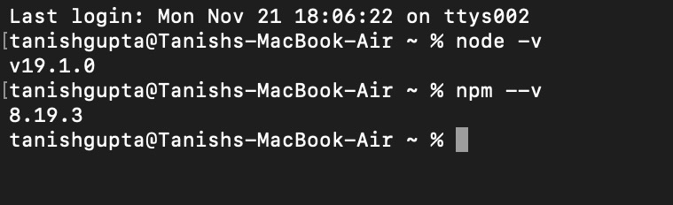
CODE SNIPPETS
Install React Js from Google:
Node -v is a Command to check whether the package was installed or not. It gives the version of node Js.
Npm(Node Package Manager) —v It also tells the version of your REACT

Slide 8
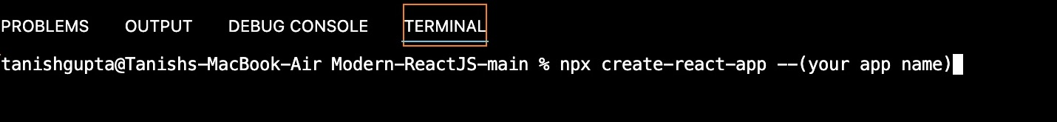
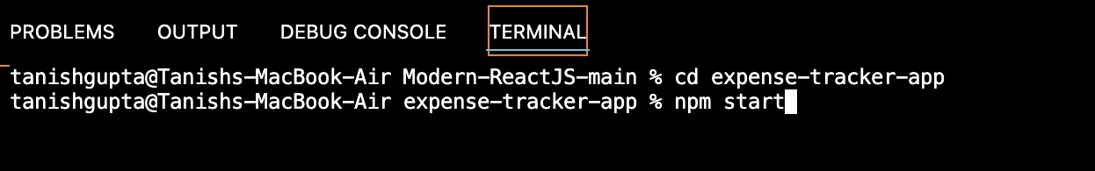
How to create the App
Firstly you have to install the react and then use this command (NPX create-react-app —your app name).
It will take sometime for being created.
NPX is Node Package Execute
Then After creating your App. Call it by using cd command.
After it Enter NPM start command and it will redirect you to your Default Browser if your app successfully running.

Slide 9

NPM AND NPX
NPM:The name NPM (Node Package Manager) stems from when NPM first was created as a package manager for Node JS.
All NPM packages are defined in files called package.json.
The content of package.json must be written in JSON.
NPX: The NPX stands for Node Package Execute and it comes with the NPX, when you installed NPX above 5.2.0 version then automatically NPX will installed.

Slide 10
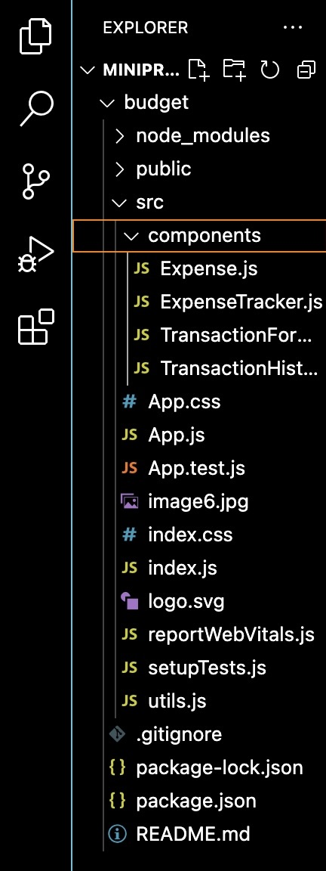

APP MAKING PROCESS
APP NAME -> SRC ->CREATE COMPONENTS >APP FILES
Miniproject is our folder name here.
Budget is our Application name.
Make a folder name Components in src.
All the files inside Components are the files used in our App where code is.
App.js , App.css etc are the main files of the App.

Slide 11
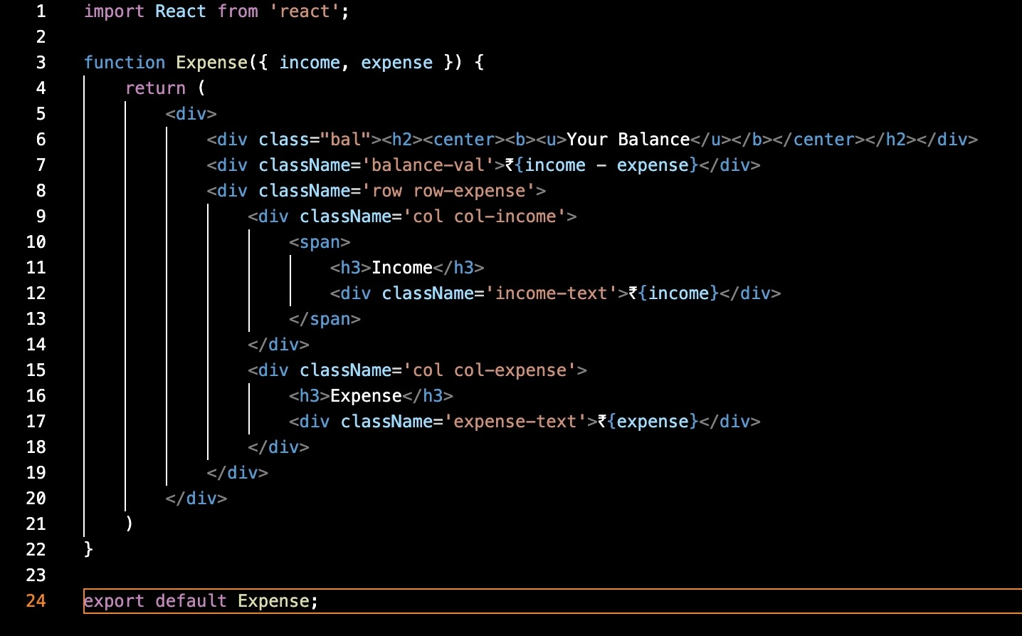
Expense.js

Slide 12
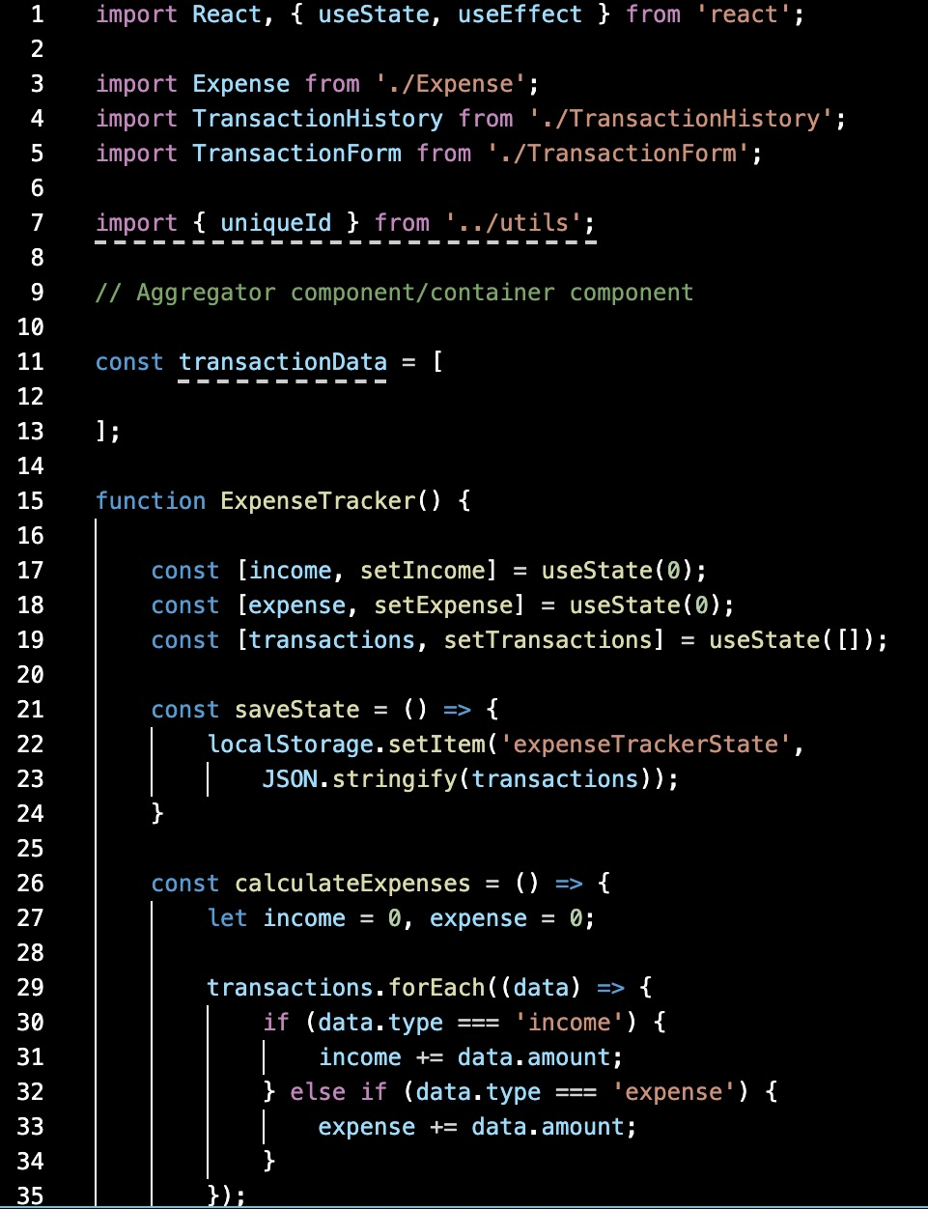
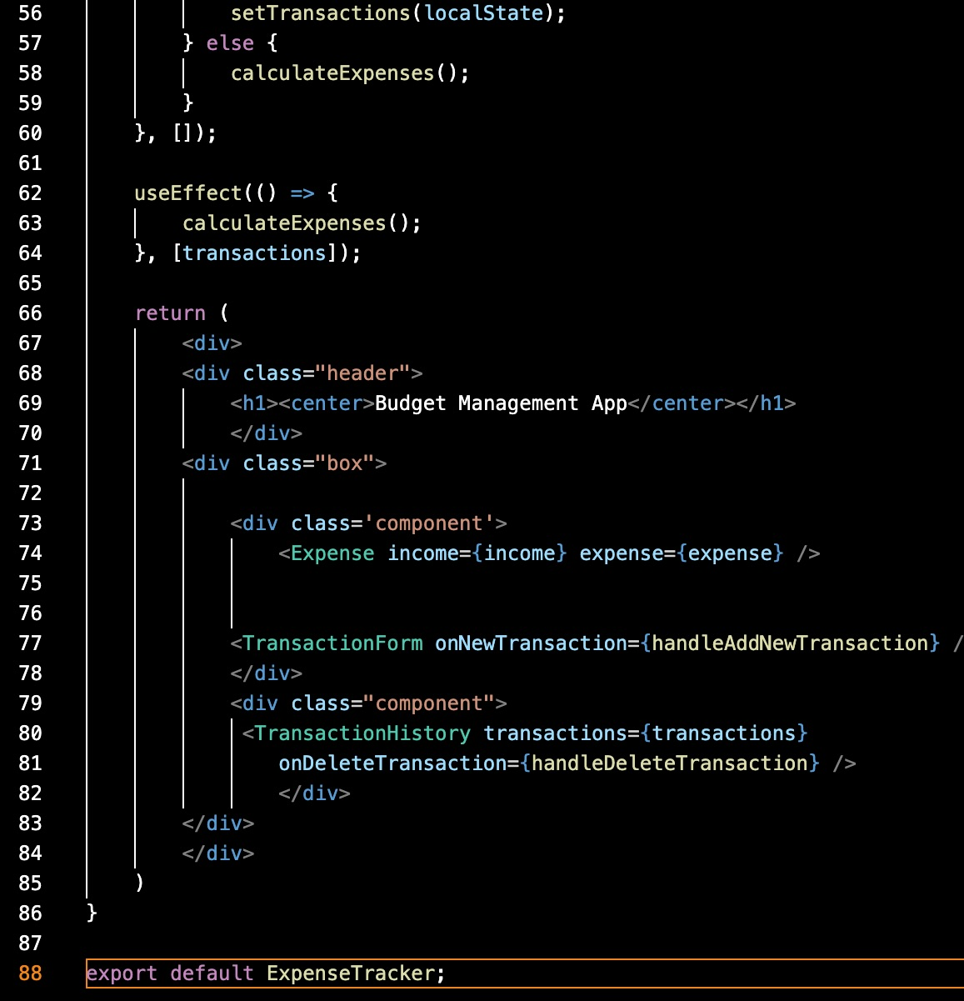
Expense Tracker.js

Slide 13
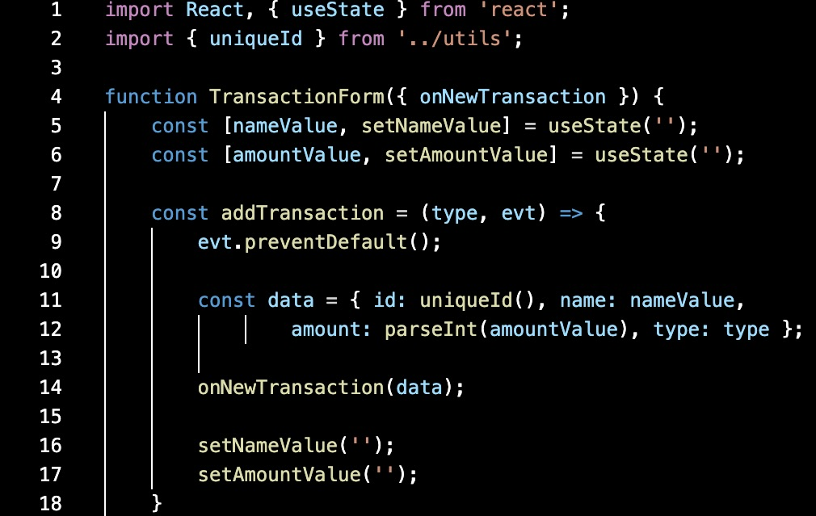
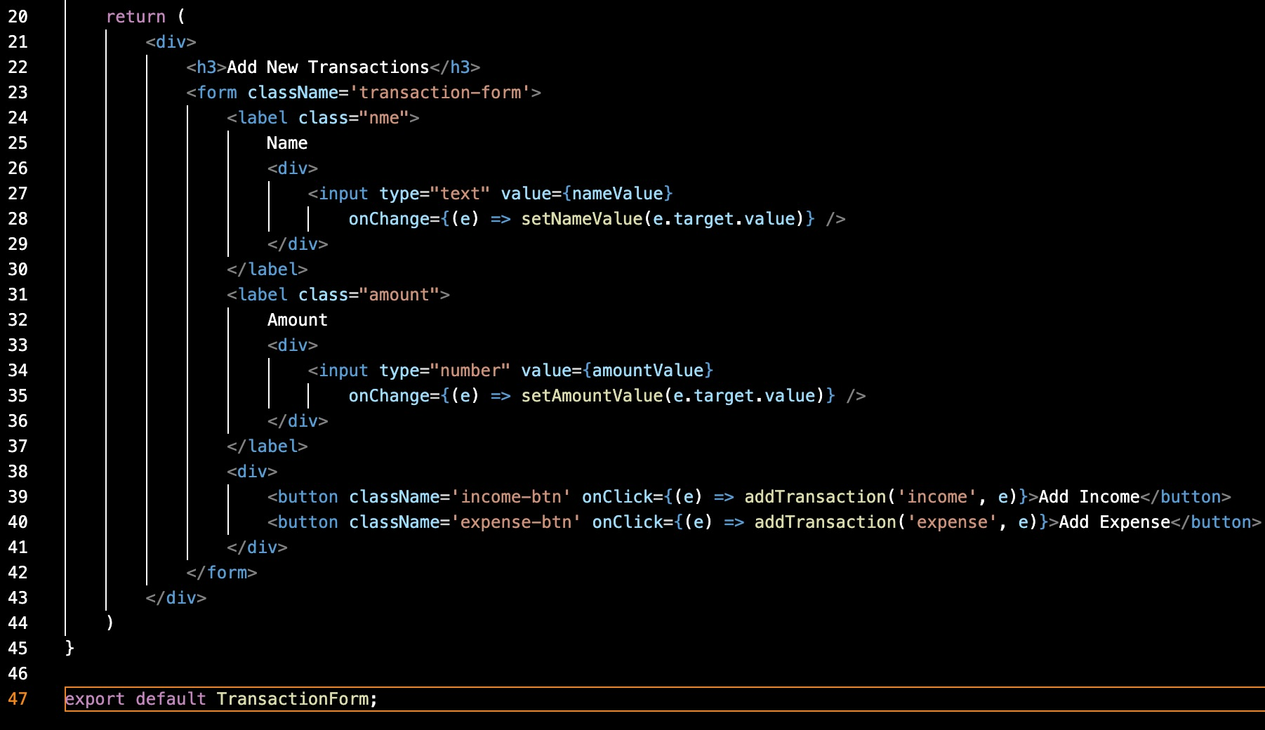
Transaction Form.js

Slide 14
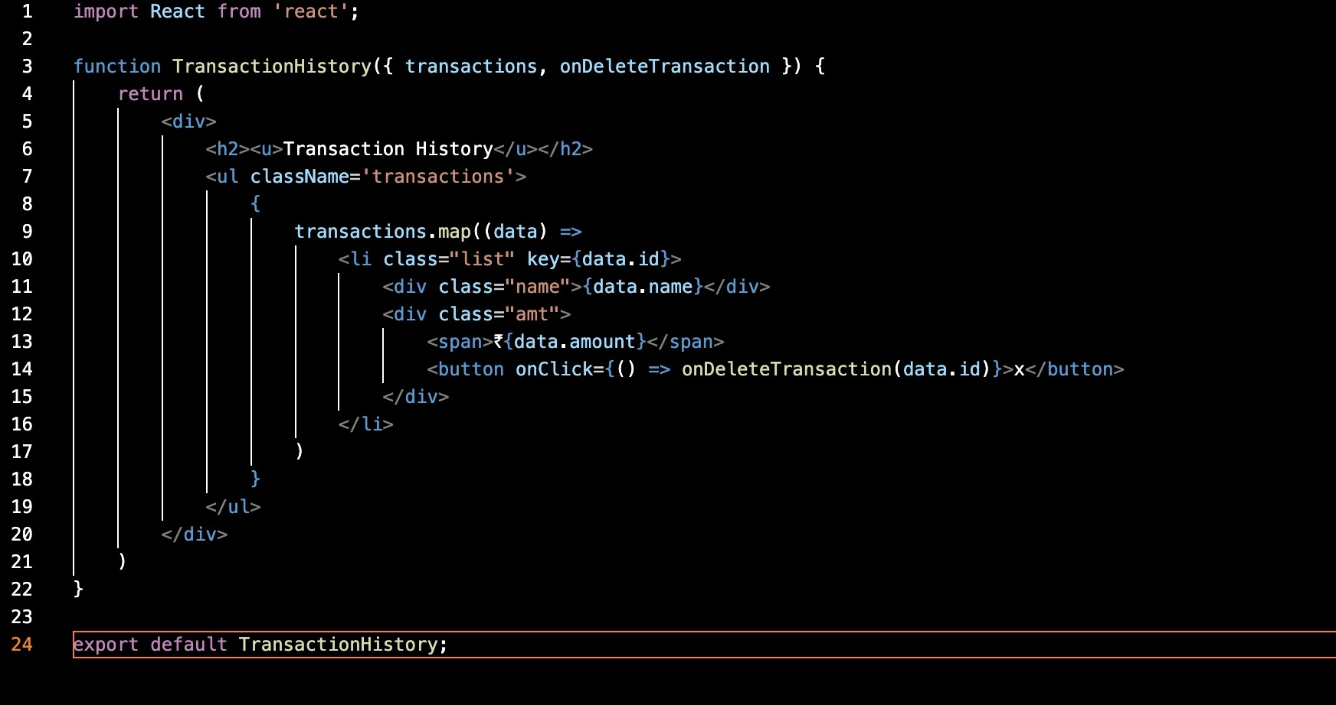
Transaction History.js

Slide 15
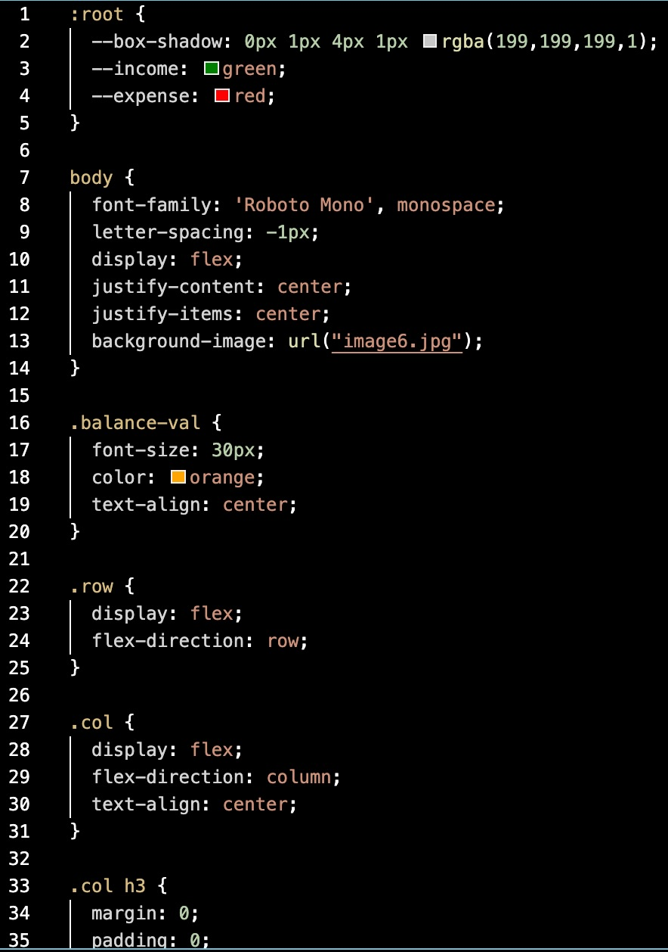
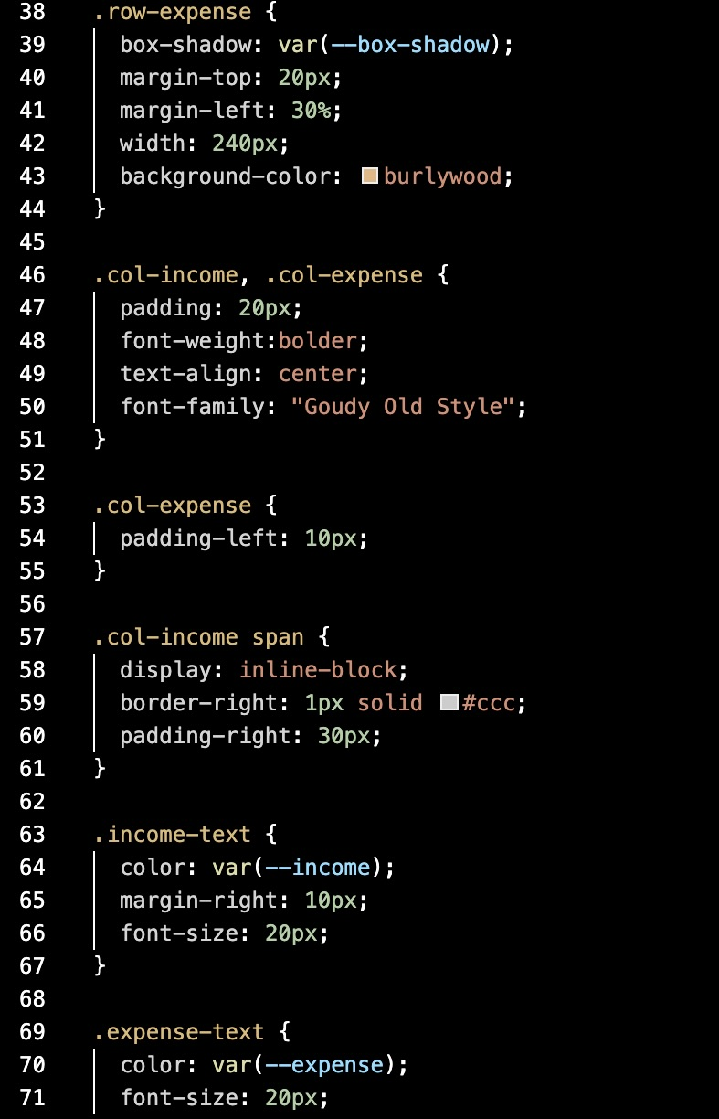
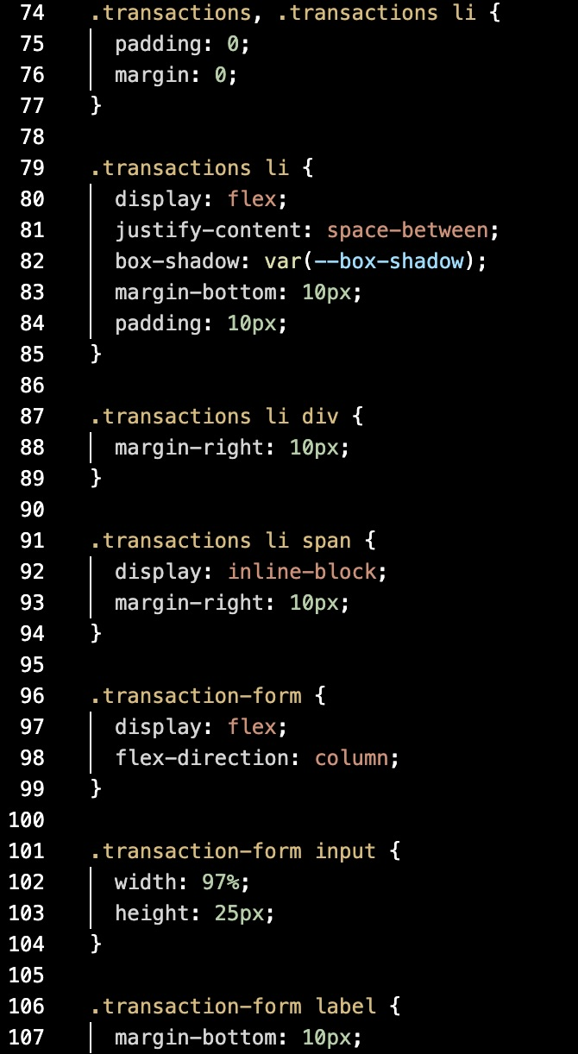
App.css
Here are some codes of our main file in which css is used for User Interface

Slide 16
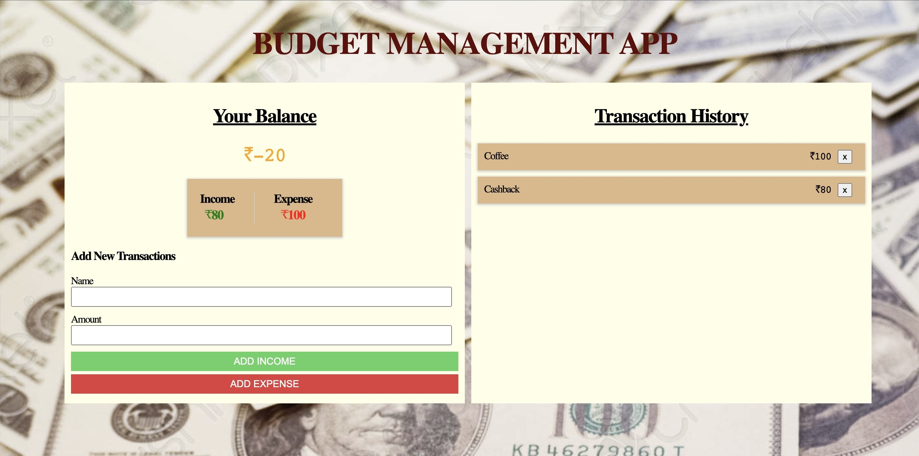
Output

Slide 17




RESOURCES
intellipaat.com
YouTube
GeeksForGeeks
Wikipedia

Slide 18

THANK YOU !

